Slide 1
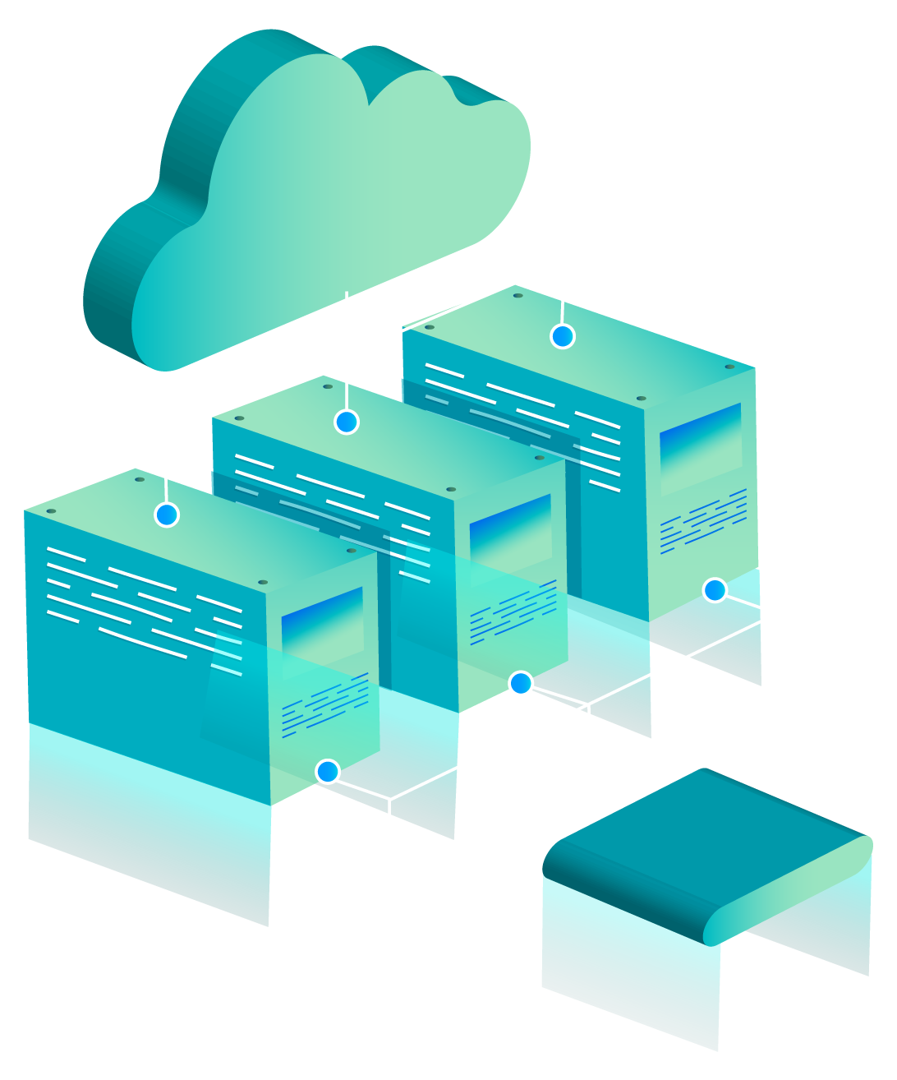
Google App Engine
Paez Diego
Román Yulliana
Valarezo Andrés

Slide 2
TABLE OF CONTENTS
Definition
Saas Paas or Iaas?
01
03
Development Environment
Bibliography
02
04

Slide 3
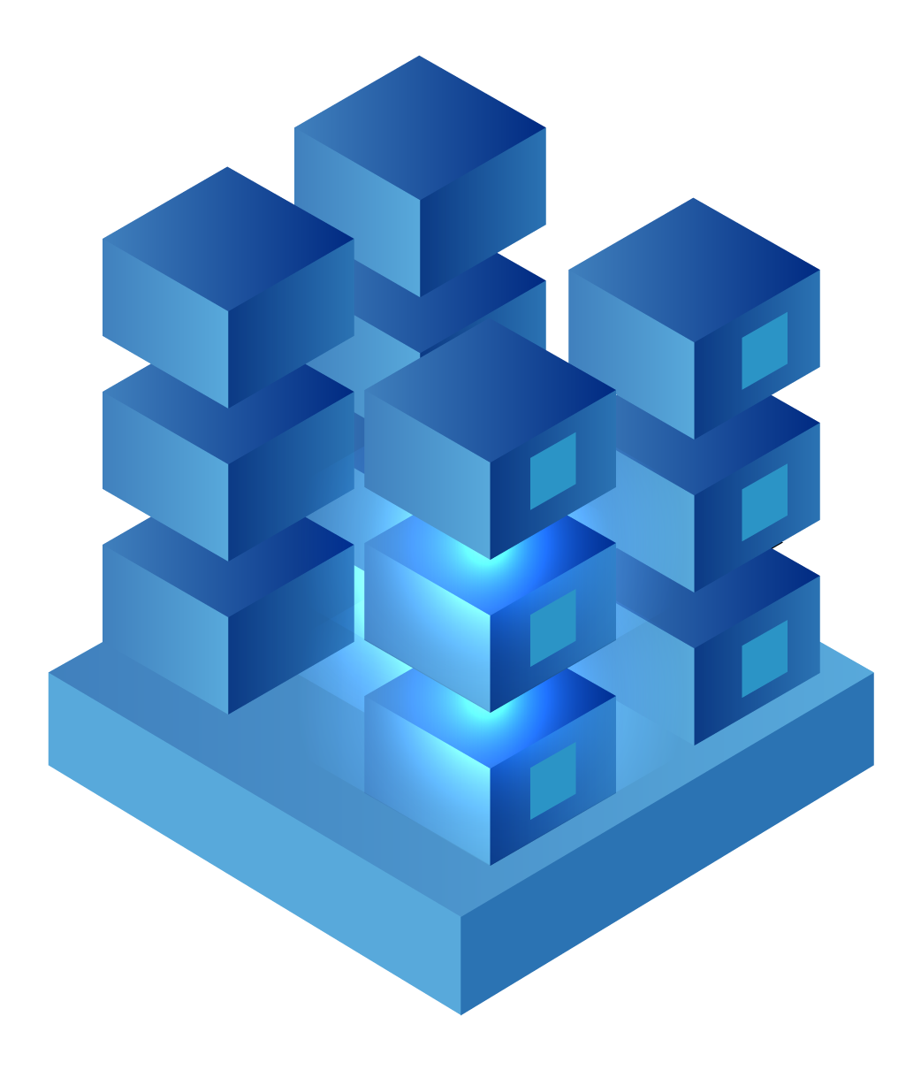
01
Definition

Slide 4
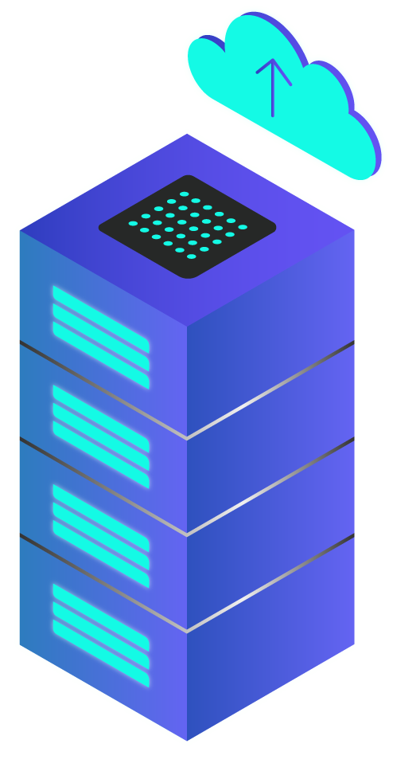
Google App Engine
A platform that enables users to run and host their web applications on Google's infrastructure.
Google App Engine is a service that allows you to host web applications within Google's infrastructure, which allows you to maintain and scale more easily.

Slide 5
02
Development
Environment

Slide 6
Features
Dynamic web service
Persistent storage with queries
Automatic scaling and load balancing
Api to authenticate users and send emails
A full-featured local development environment

Slide 7
03
Saas Paas or Iaas?

Slide 8
XaaS
SaaS
PaaS
IaaS
Use a software without consuming computer resources.
Combines vendor software and hardware, users can develop, test and deploy their own applications..
Physical and hardware elements of the supplier.

Slide 9
Bibliography
Guilherme Magalhaes, Eduardo Roloff. (August of 2012). ResearchGate. Obtained of https://www.researchgate.net/publication/296707221_Developing_on_Google_App_Engine
Zahariev, A. (27 of April of 2009). Helsinki University of Technology. Obtained of http://www.cse.hut.fi/en/publications/B/5/papers/1Zahariev_final.pdf

